Slide 1
Optimized Kth Nearest Neighbor Algorithm on an FPGA Cluster
Andrew Farran
Grant Fettig
Daniel McKee
Sponsored By: Lina Sawalha, Ph.D
Notes:
Grant

Slide 2

Applications of Machine Learning
& Why Speed is Important
Weather Prediction
Economic Forecasting
Computer Vision
Navigation Systems
Fraud Detection
Medical Research
Notes:
Applications: weather prediction, economic forecasting, and computer vision
data daluge-huge amount of data being generated every hour and there is a persiting need to process it at a higher speed.
We need better faster hardware to process this data. For this project we design a prototype an fpga cluster that is capable of high performance computing

Slide 3
Project Goals
Reusable FPGA cluster prototype
Optimized knn algorithm using systolic array implementation in an FPGA
Speedup kth nearest neighbor algorithm by increasing the number of processing units in cluster
Show how multiple FPGAs can run algorithms faster than multi processor systems
Notes:
FPGA cluster shall be a prototype that can be further used to accelerate multiple different algorithms in the future.

Slide 4
What Is Kth Nearest Neighbor (KNN)
Machine learning classification algorithm
Highly parallelizable algorithm
Notes:
give cancer detection application
Test vector, train vectors k=8 6 red, 2 blue
ighly parallelizable which I’ll explain later

Slide 5

What is Parallel Computing?
Sequential Computations
d1=(x1-y1)*(x1-y1)
d2=(x2-y2)*(x2-y2)
d3=(x3-y3)*(x3-y3)
….
n. dn=(xn-yn)*(xn-yn)
Parallel Computations
d1=(x1-y1)*(x1-y1) 2. d2=(x2-y2)*(x2-y2) 3. d3=(x3-y3)*(x3-y3) … n. dn=(xn-yn)*(xn-yn)
Notes:
Parallel computing is essential with
Sequential is doing one problem at a time
Parallel is doing multiple problems at a time
Problems can be done in parallel if they don't need to wait for a previous problem to be done to get a correct result. This is called a data dependency.
Parallel computations can be done by mult core processors, GPUs, or in our case using a cluster of FPGAs

Slide 6
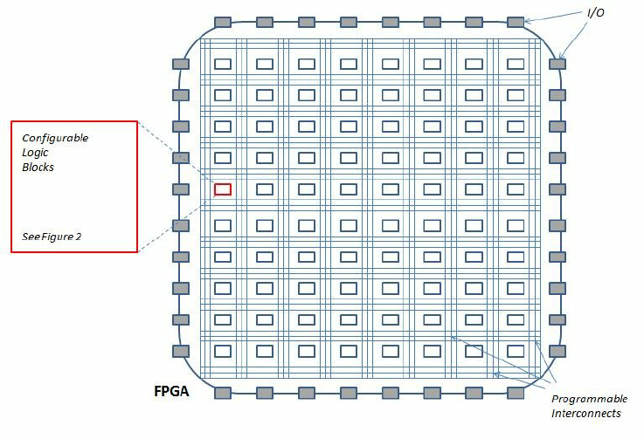
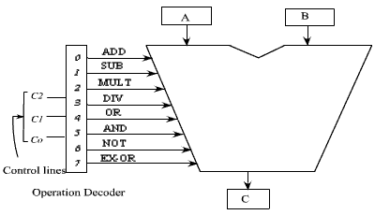
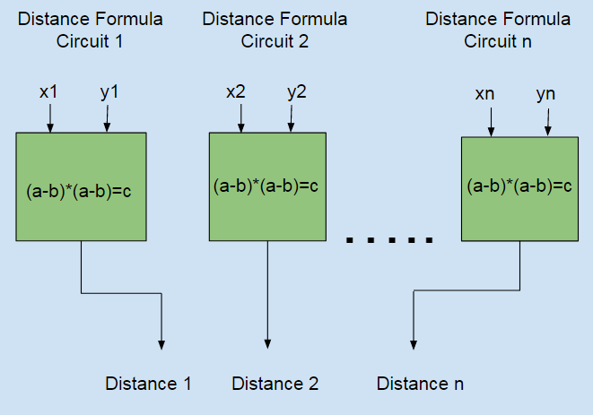
Benefits of using an FPGA over a CPU
FPGA (Field-programmable gate array)
CPU ALU(Arithmetic Logic Unit)
FPGAs have dedicated hardware to solve a target problem
FPGAs consume less power than CPUs
Notes:
Each of these block are programmable
Use HDL(hardware descriptive language) to describe the circuit
CPU decides which instruction to use, then sends inputs to alu and correct hardware inside

Slide 7
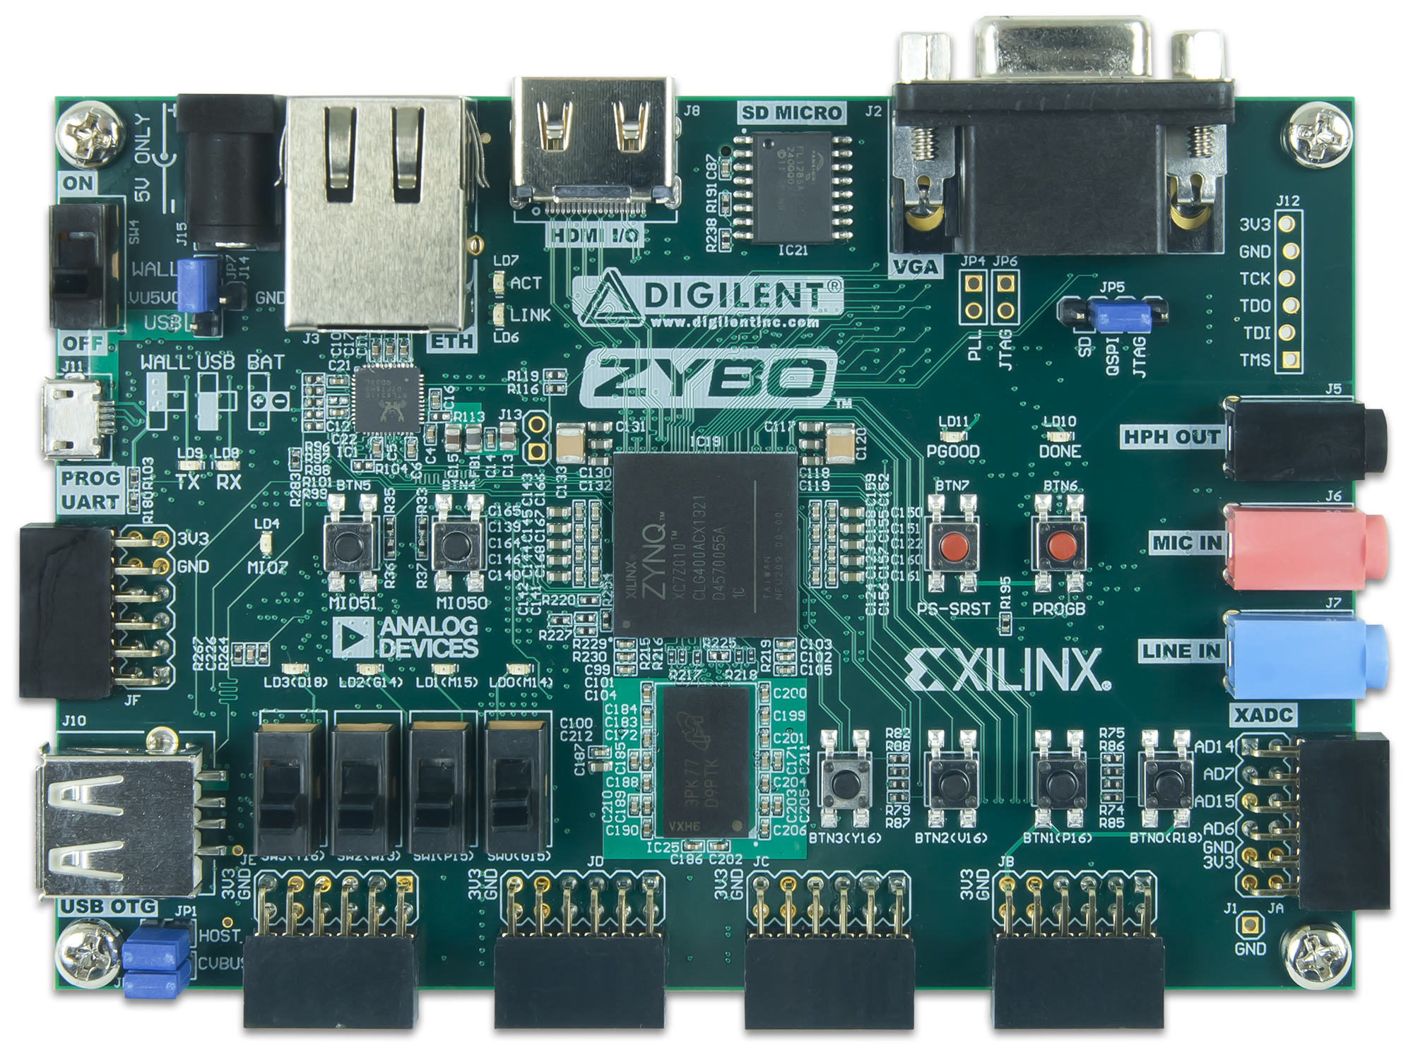
Zybo Zynq-7000 ARM/FPGA SoC
650 MHz dual-core Cortex™-A9 processor
Xilinx 7-series FPGA
On board DRAM
1 Gigabit Ethernet PHY
Notes:
One of the major components of our project
ARM processor that controls dataflow throughout the Zybo
FPGA to do the arithmatic
DRAM for buffers between PC and FPGA
Ethernet port to send data between PC and Zybo
MENTION ITS A XILINX FPGA

Slide 8
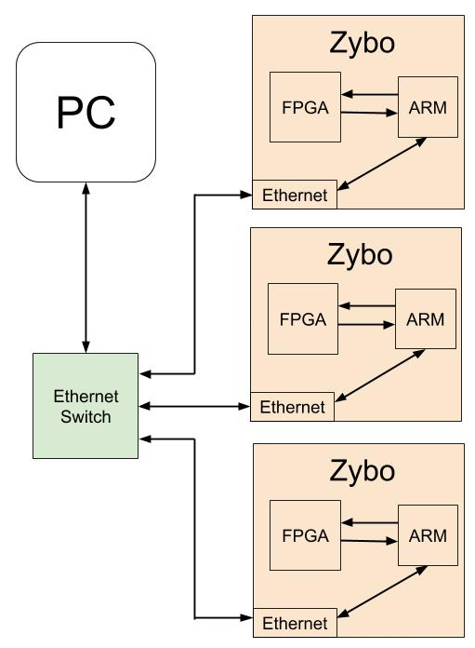
Zybo Cluster
Compatible with 1-4 Zybos
Communications are done via Ethernet
Zybos compute distances
PC sorts Kth Nearest
Notes:
Discuss figure

Slide 9
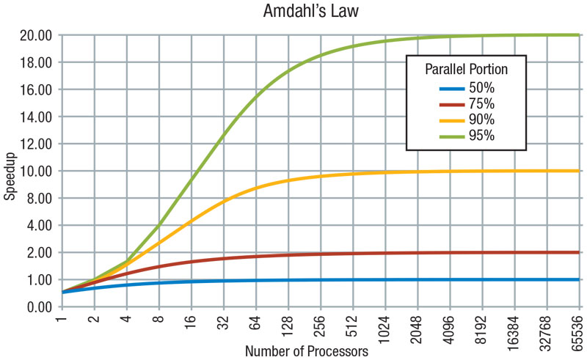
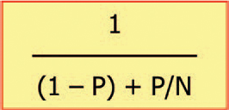
Amdahl’s Law
N is the amount of Zybos
P is the portion of the algorithm that can be sped up by increasing N
Number of Zybos
[https://en.wikipedia.org/wiki/Amdahl%27s_law#/media/File:AmdahlsLaw.sv]
Notes:
Ahmdals Law gives the theoretical speedup of the execution of a task that is a fixed workload.
N is the number of Zybos
P is the portion of time it takes to do the distance formula
As N goes to infinity the speedup increases but by less.
Dan will now walk use through the steps the cluster takes to obtain the kth nearest neighbors
When designing parallelized systems this needs to be taken in consideration because of the diminishing returns.

Slide 10
PC Data Distribution
Read integers from a binary file
Create a client socket with a unique IP address, port number, and MAC address
Split data evenly and sends
...
Portion 1
Portion 2
...
Portion N
Zybo 1
Zybo 2
Zybo N
...
Notes:
Andrew, Methodology slide before: python script for PC comm., Xilinx vivado verilog for FPGA, C for ARM control, number of cycles test metric

Slide 11
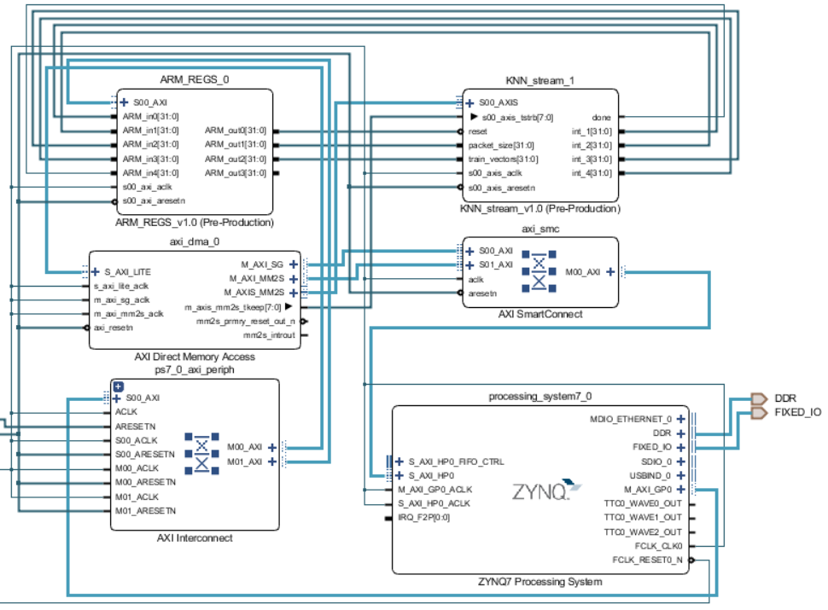
Zybo ARM Processor
Create a server socket with a matching IP address, port number, and MAC address
Receive all ethernet packets
Send packets to FPGA
Wait for FPGA to be done
Notes:
Discuss Figure !!

Slide 12
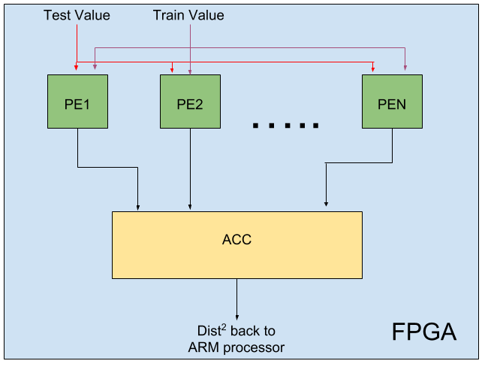
Systolic Array Implementation of Knn
Network of processing elements (PE)
Effective for data level parallelism algorithms
Simple to connect and add more for increased parallelism
Notes:
We developed a systolic array implementation for KNN.
Works well with DLP

Slide 13
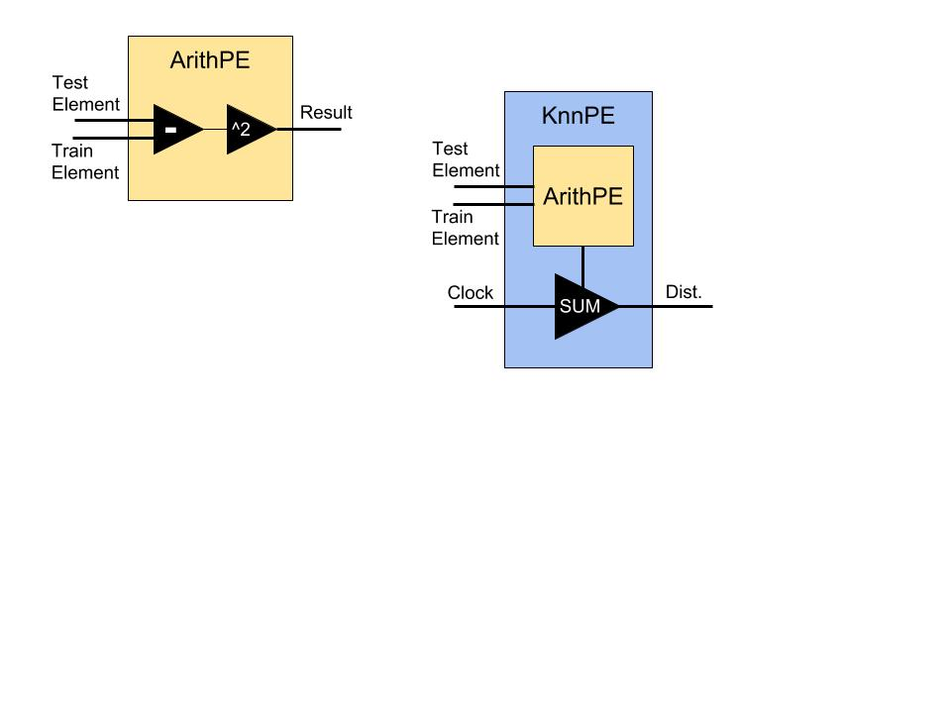
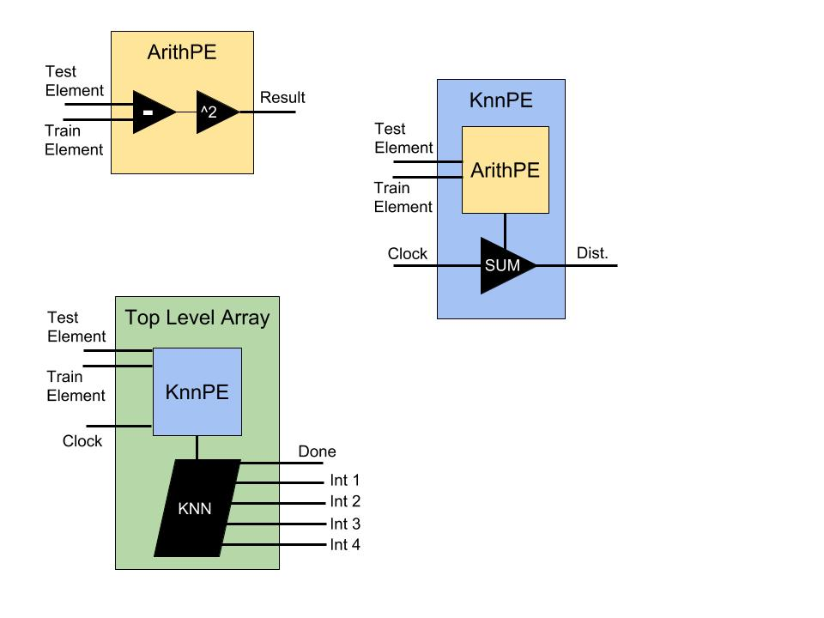
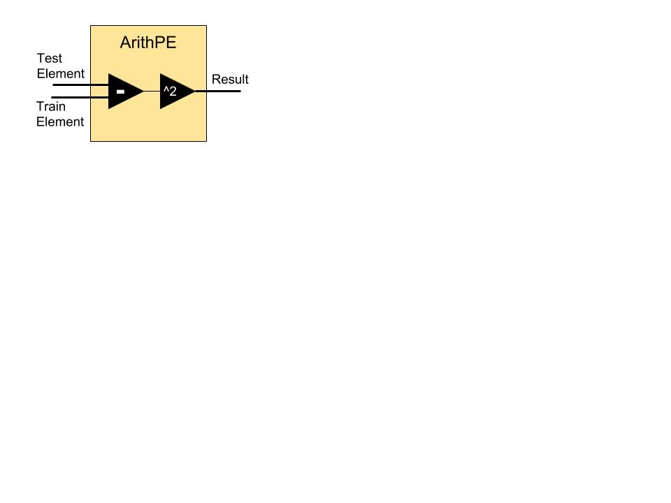
FPGA Computations
Modular design of Processing Elements
Notes:
Dan, systolic array before this slide: define and describe works well for data level parallelism applications

Slide 14
Obtaining the Kth Nearest from the Cluster
Zybo
PC
PC
Zybo
Zybo
Combine lists and find the Kth nearest
Find their own Kth nearest
Notes:
Dan

Slide 15
Methodology Slide
Xilinx Vivado IDE to design Zybo system and FPGA logic
Xilinx SDK to control data transfer from ARM processor
Multithreaded Python script to communicate between PC and each Zybo via ethernet
Notes:
HOT NEW SLIDE WHO WANTS IT
Creating flexible FPGA logic and higher level code was not only important for future users to work with the cluster, but it made debugging issues much smoother
The next step was to get the DMA to functions properly as that is the driving force of data movement
Once we were able to get the DMA created so that we were able to use it to transfer data, we needed to configure the Ethernet so that the PC could communicate with the Zybo boards
Finally, we created the Python script that

Slide 16
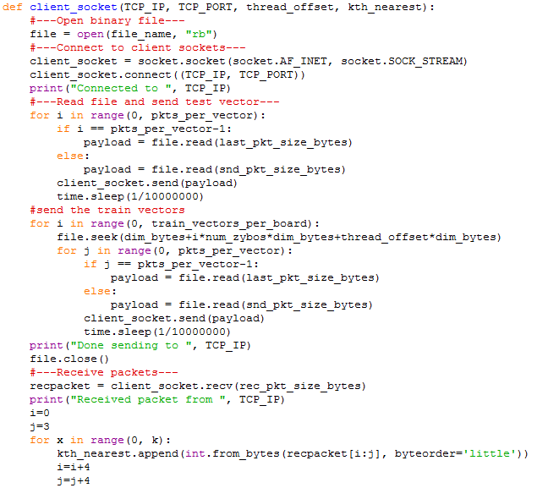
PC Client Socket Code
N (number of Zybos) threads running in parallel
Connect to socket
Read File
Send data to Zybos
Wait and receive data from Zybos
Notes:
MENTION MULTITHREADING

Slide 17
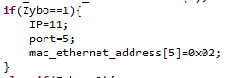
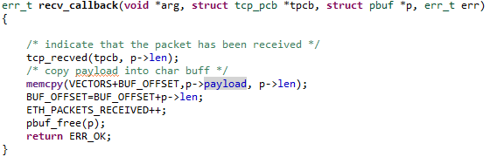
Zybo Server Socket & Data Flow Code
Set unique IP Address, Port, and MAC Address
Receive packets and puts into buffer
Notes:
Dan
Why do we need to reorganize

Slide 18
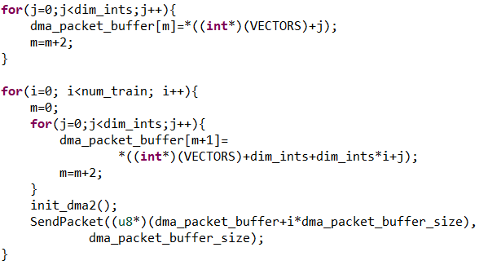
Zybo DMA Control
DMA: Direct Memory Access
Reorder data and send to the FPGA
100 Training Vectors
1 Test Vector to compare
10,000 dimensions/vector
Buffer of 20,000 elements: Loaded with the test vector and a train vector
Notes:
Dan
Mention that this happens in ARM

Slide 19
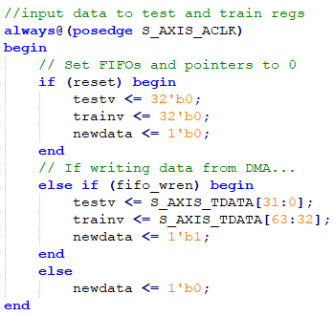
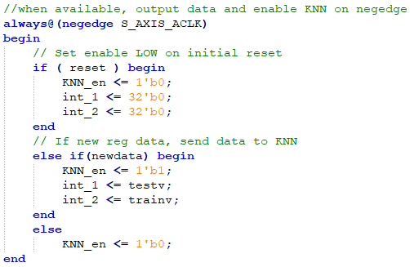
HDL Top Module
HDL: Hardware Descriptive Language (e.g. Verilog)
Notes:
Point to specific parts of the code when discussing

Slide 20
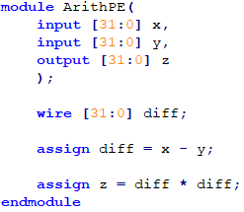
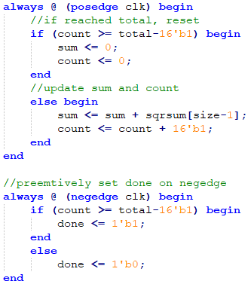
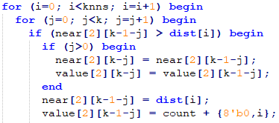
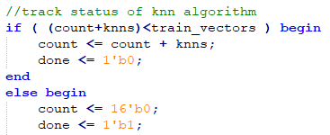
HDL KNN Calculations
Arithmetic PE
KNN PE
Top Level Array

Slide 21
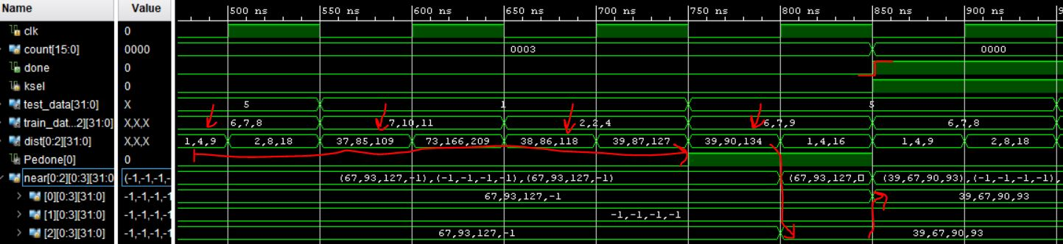
HDL Testing
Behavioral simulation to observe functionality
6 Train vectors
3 compares each cycle
k = 4

Slide 22
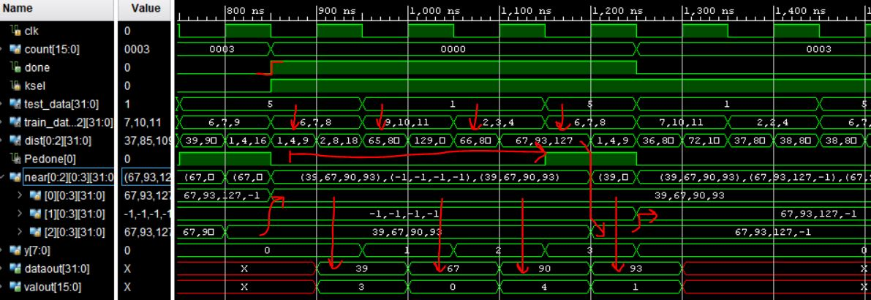
HDL Testing Continued
Results are able to be output sequentially

Slide 23
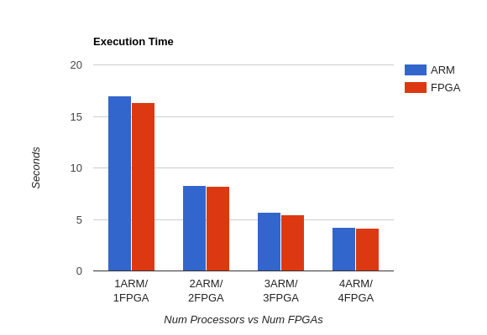
Results
CPU only with sequential computation
Timing for one FPGA
Timing for multiple CPU
Timing for multiple FPGA
Notes:
Dan Ends
CPU only (sequential)
Simulation counter -> execution time
Make graph

Slide 24
Improving Communications & Dataflow
Ethernet was the easiest, not the fastest
Format of how data is sent and received through Ethernet and DMA
Increasing DMA width
Notes:
And starts

Slide 25
Improving HDL
Increase DMA data width
Potential to utilize more PEs
Split the sorting across multiple cycles
Increase clock frequency
Utilize a different board with a larger FPGA or one which supports direct access to RAM from FPGA
No need to reorder data in ARM processor
Notes:
Daniel the maniel
Utilize a different board that supports accessing RAM from FPGA directly or has more FPGA resources

Slide 26
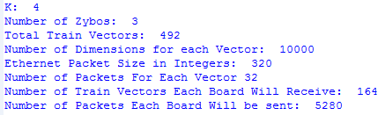
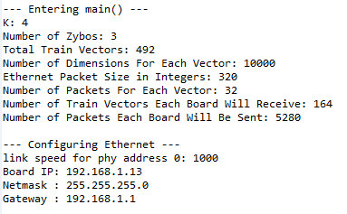
Reusability
Any algorithm that is highly parallelizable will be improved by the cluster
The code that controls ethernet communications supports 1-4 Zybo boards
Notes:
Andrew

Slide 27
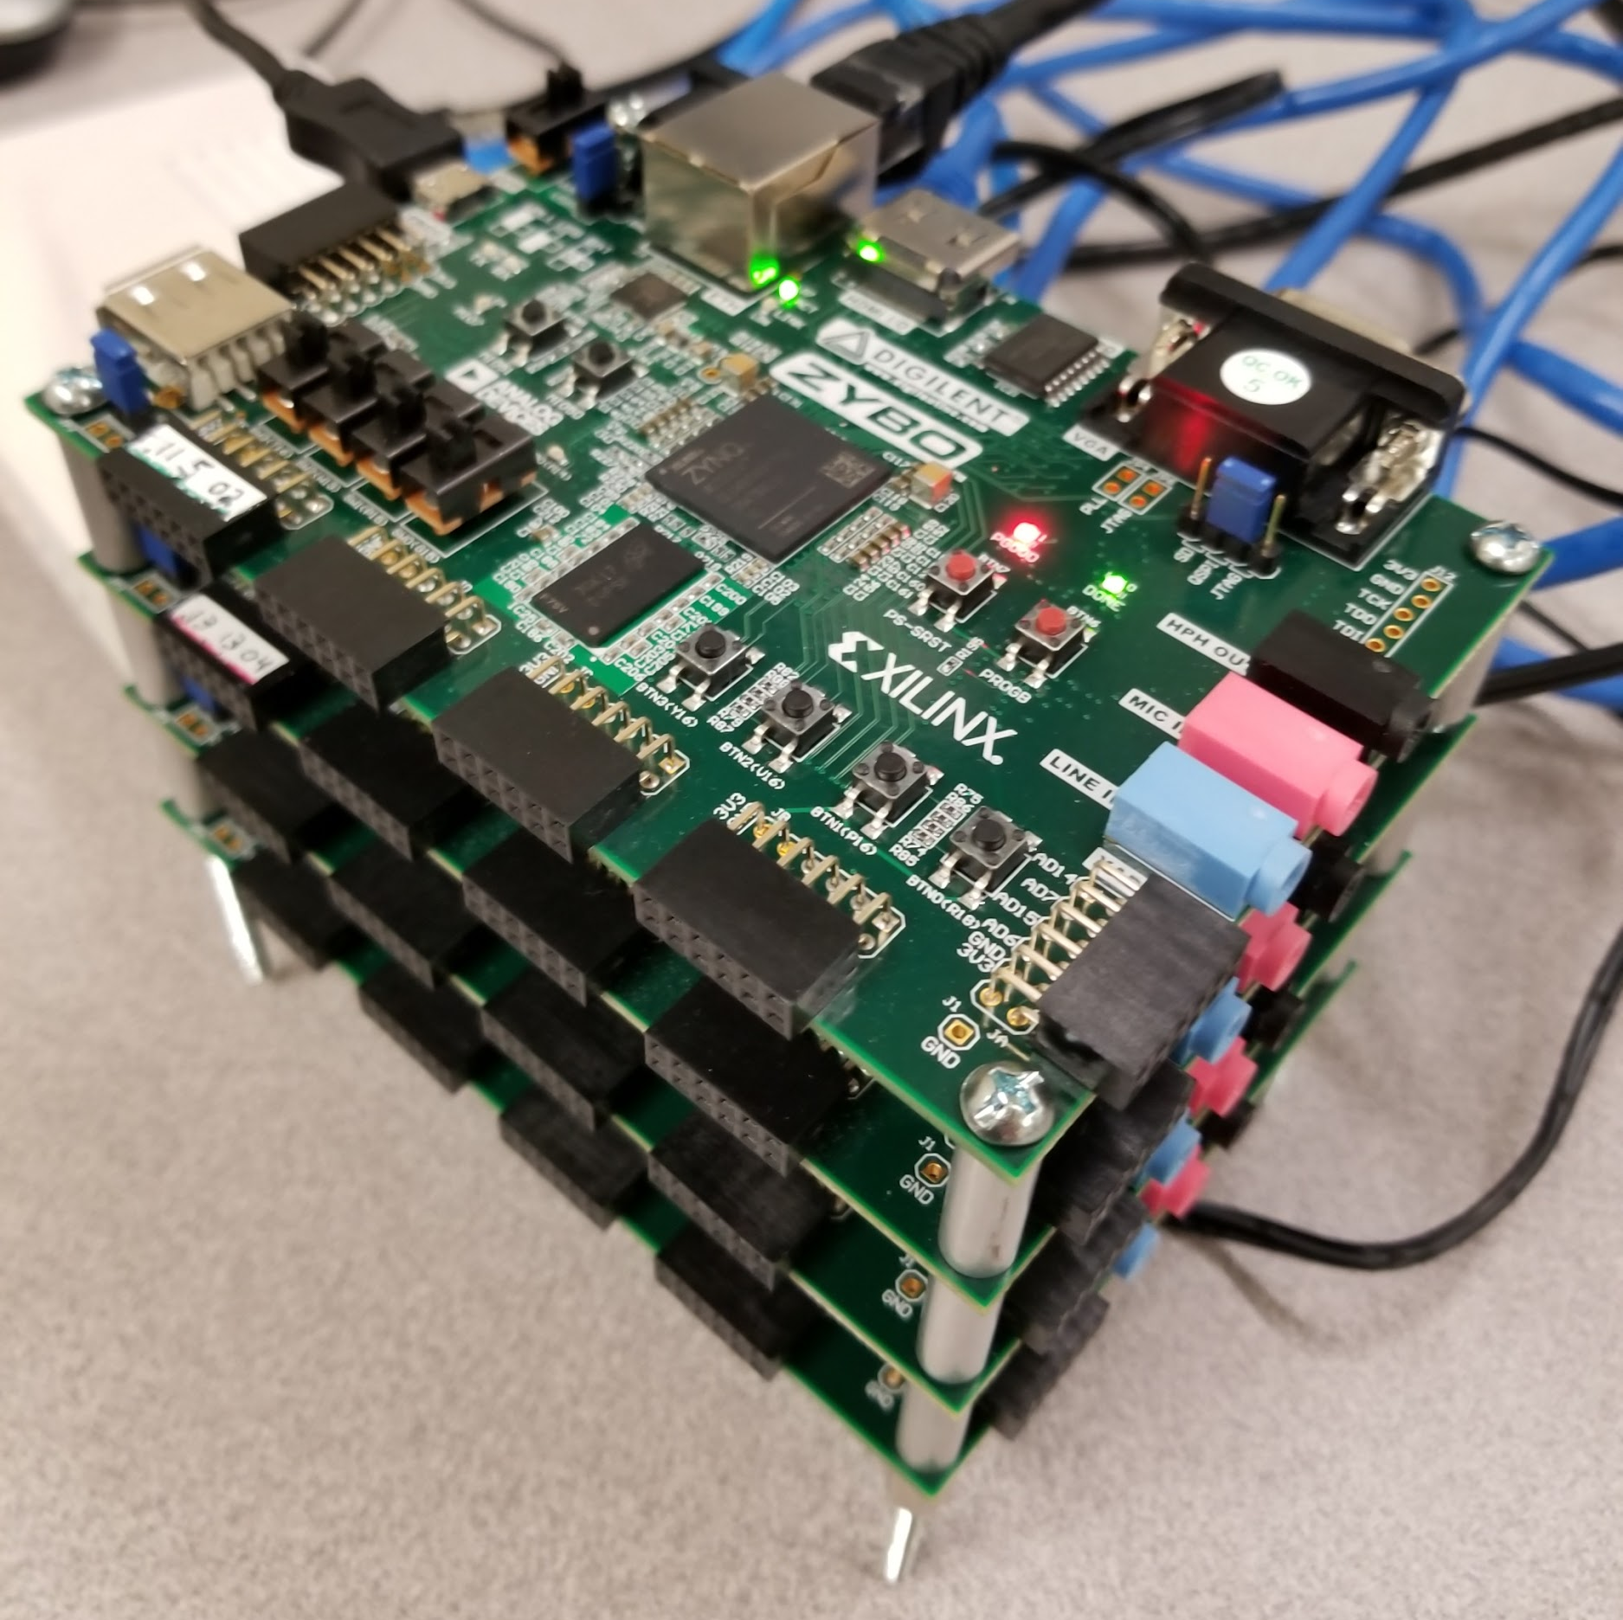
Contributions
A reusable FPGA Cluster
Parallelized KNN in Verilog using Systolic Array implementation
Multithreaded Python Ethernet Communications Code
Zybo Ethernet Communications Code
Notes:
created systolic array
created cluster prototype
parallelized knn
socket things

Slide 28
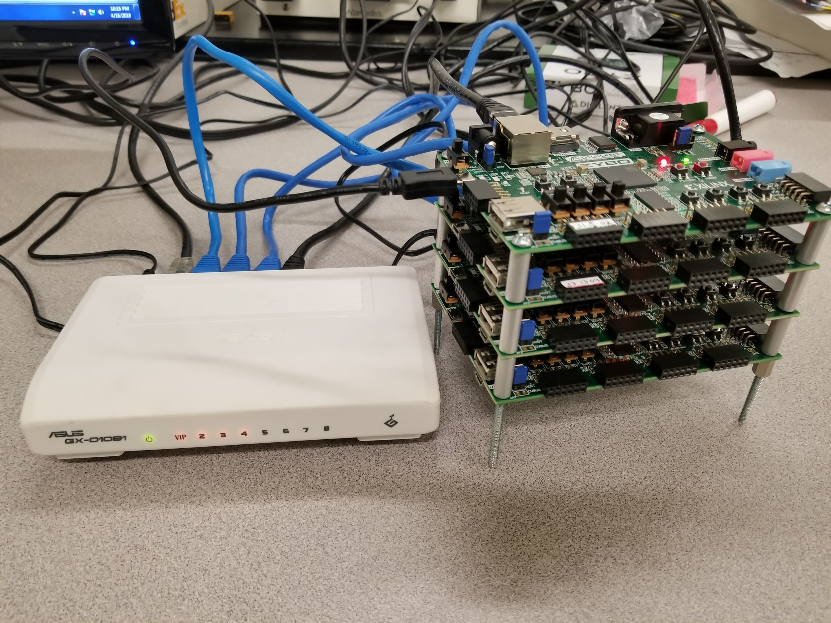
Takeaways
C & Python Socket Programming
Vivado HDK(Hardware Development Kit)
Vivado SDK(Software Development Kit)
Ethernet Communications
Synchronous HDL Programming
Debugging Hardware with Software
Notes:
Probably a better place to put this pic if we include it at all
why using PCi will be faster

Slide 29
References
https://reference.digilentinc.com/reference/programmable-logic/zybo/start
student desk pic
http://examradar.com/arithmetic-logic-unit-alu/
David Norwood, https://www.researchgate.net/figure/FPGA-Diagram_fig2_236013064
https://verificationacademy.com/verification-horizons/june-2013-volume-9-issue-2/The-Need-for-Speed-Understanding-Design-Factors-that-Make-Multi-core-Parallel-Simulations-Efficient
https://en.wikipedia.org/wiki/Amdahl%27s_law#/media/File:AmdahlsLaw.svg
https://towardsdatascience.com/introduction-to-k-nearest-neighbors-3b534bb11d26

